Slide 1

Guess Songs final submission version
Wang Zitong 22207273 2024.12.20

Slide 2
Alpha’s Implementation

Slide 3
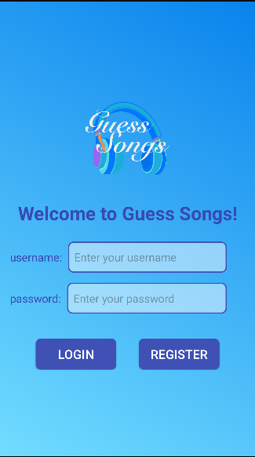
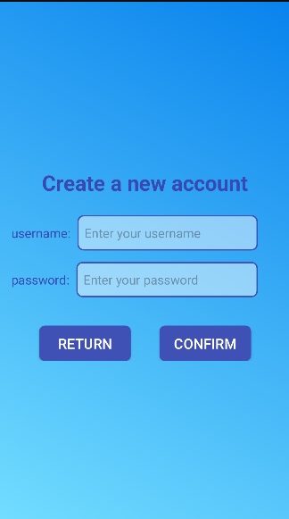

Accounts
Content:
The user need an account to uses this app and stores data.

Slide 4
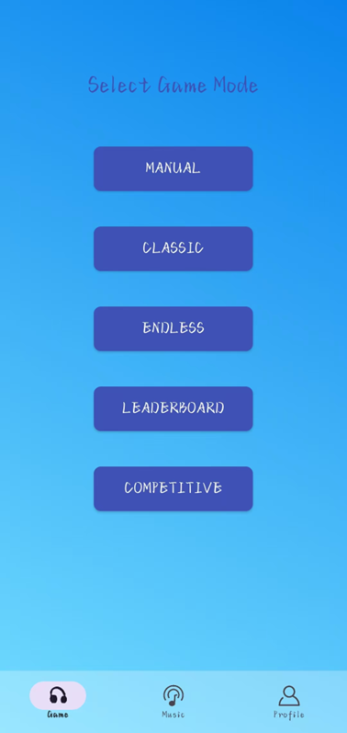
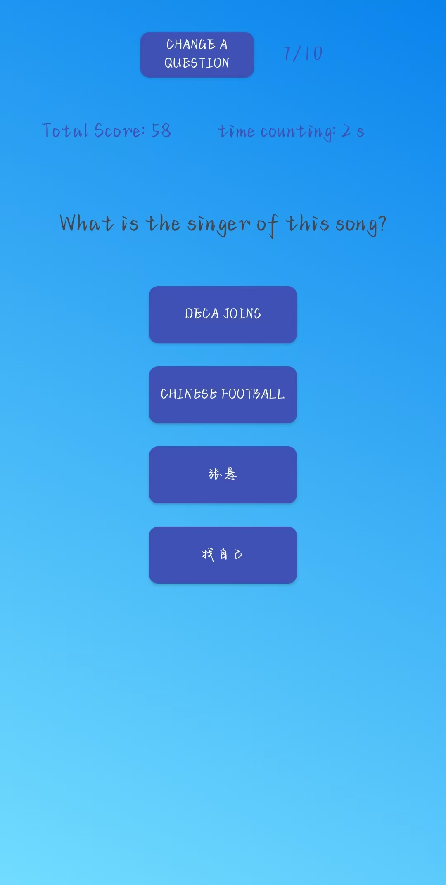
Basic Mode
Content:
self-playing mode,only one player in the game
Generate random questions to keep things interesting

Slide 5
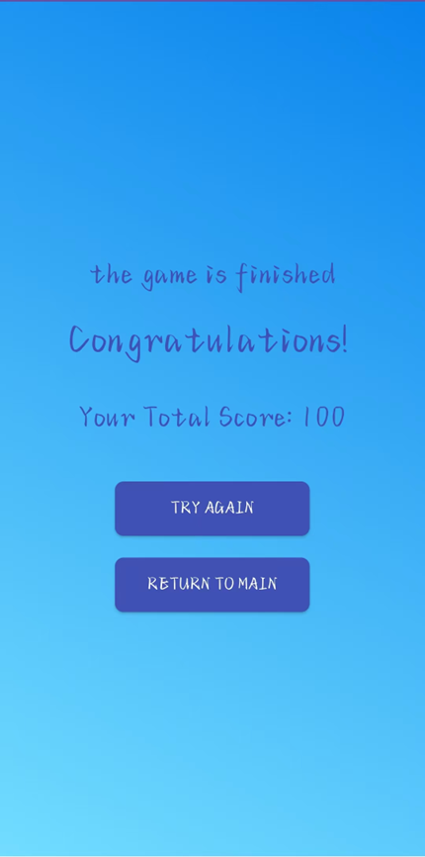
Basic Mode
Content:
Each game contains 10 questions, after finish all questions, the game is over.
Then the app will skip to the summary page, which shows the score and the highest score in history.

Slide 6
Alpha- Working Features
1. Complete the single-player mode
Implement offline game logic, generate random questions and answers, and ensure the questions are engaging.
2. Data storage
Use a local database to store user data, which will assist in the development of historical data query features in the future.
3. UI design
Designed a unique icon for the app and established the overall UI design tone.

Slide 7
Beta’s Implementation

Slide 8
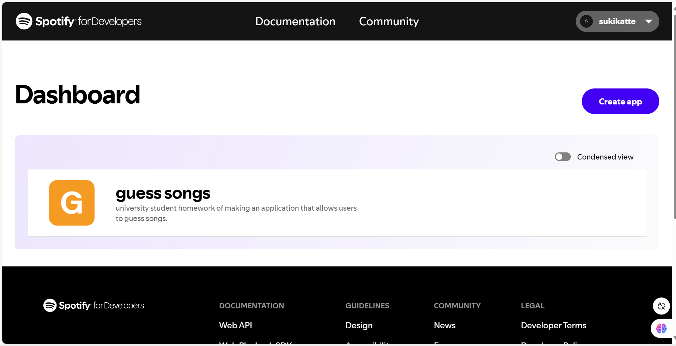
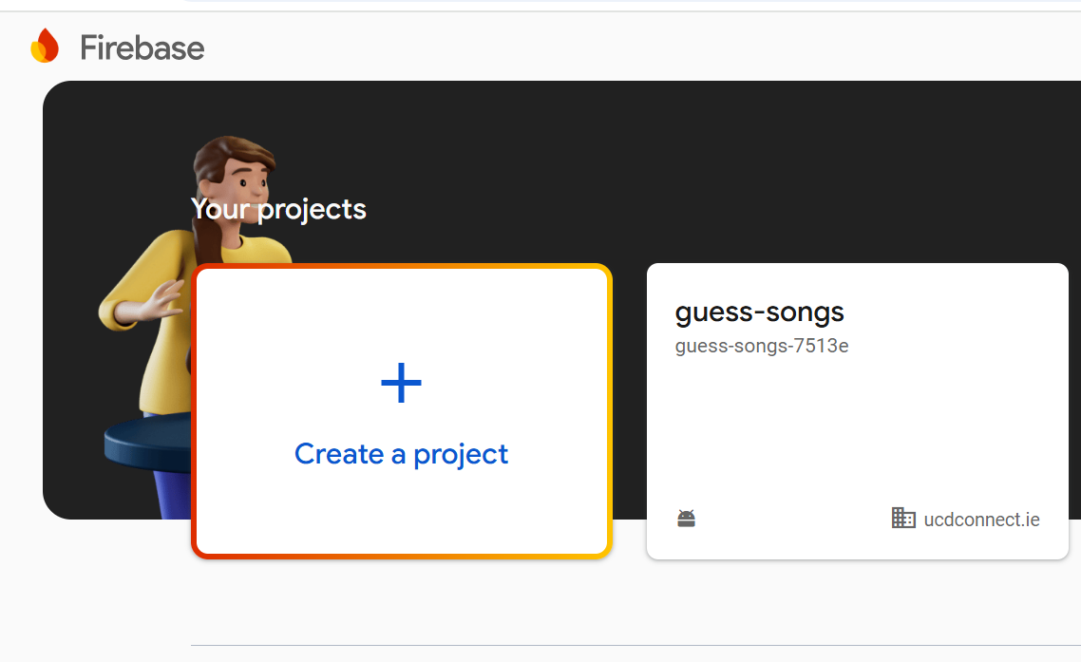
BETA-Update My Final Goal
Multiplayer Online Song-Guessing Game
Android-based, integrated with Spotify & Firebase

Slide 9
BETA-Project Overview
Objective:
A multiplayer song-guessing game where players interact in real-time, guess songs, and compete based on music knowledge.
The game integrates Spotify for music playback and Firebase for managing user scores and game data.
Core Features:
Multiplayer mode (up to 3 players).
Real-time synchronization of player scores and data via Firebase.
Song library integrated with Spotify API.

Slide 10
BETA-New Features
Multiplayer Mode:
Supports up to three players in a single game session.
Real-time synchronization of player scores and answers using Firebase.
Players must confirm readiness before the game starts.
Song Library & Playback:
Dynamic song database stored in Firebase (song titles, artists, Spotify URIs).
Songs played directly from Spotify API for an immersive experience.

Slide 11
Current Status
Multiplayer Mode:
Completed: Player entry into the game room and synchronization of player data.
In Progress: Syncing of player answers, scores, and questions during the game.
Online Song Library:
Completed: Integration with Spotify API for song playback (sample project setup).
In Progress: Full connection to the Spotify API to play songs dynamically.

Slide 12
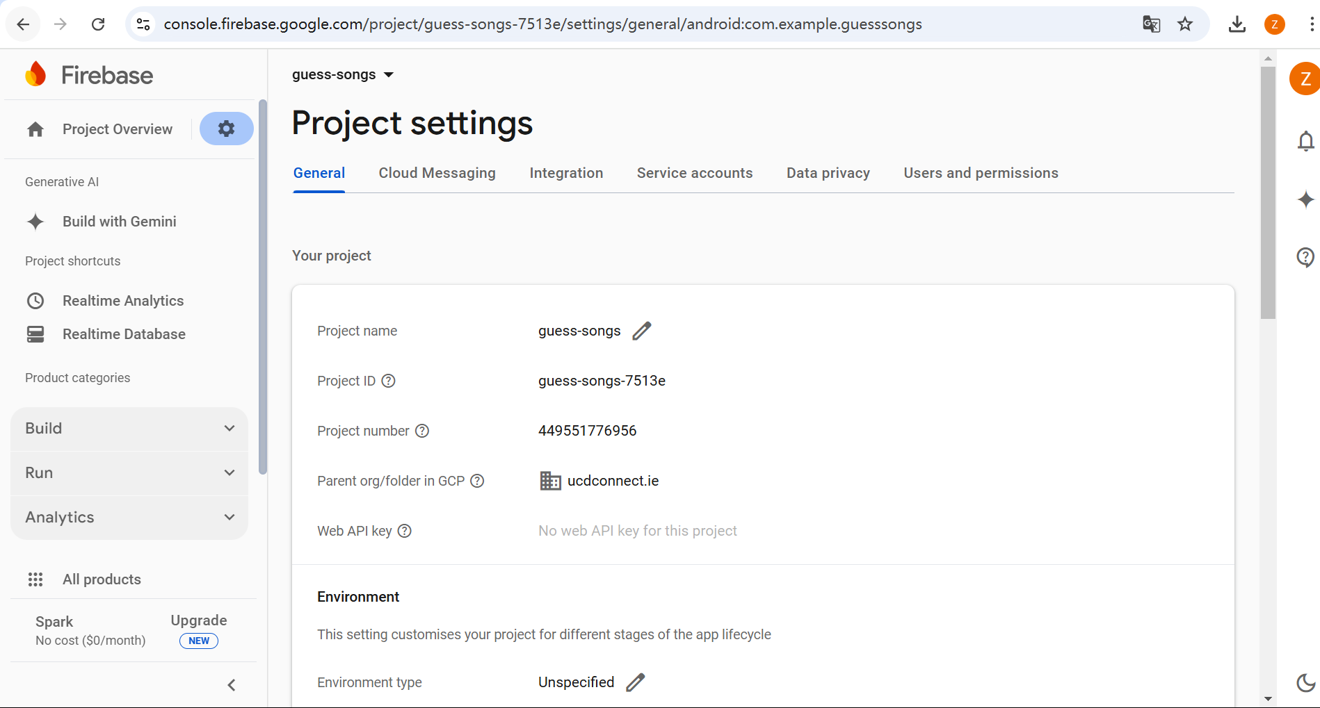

Slide 13
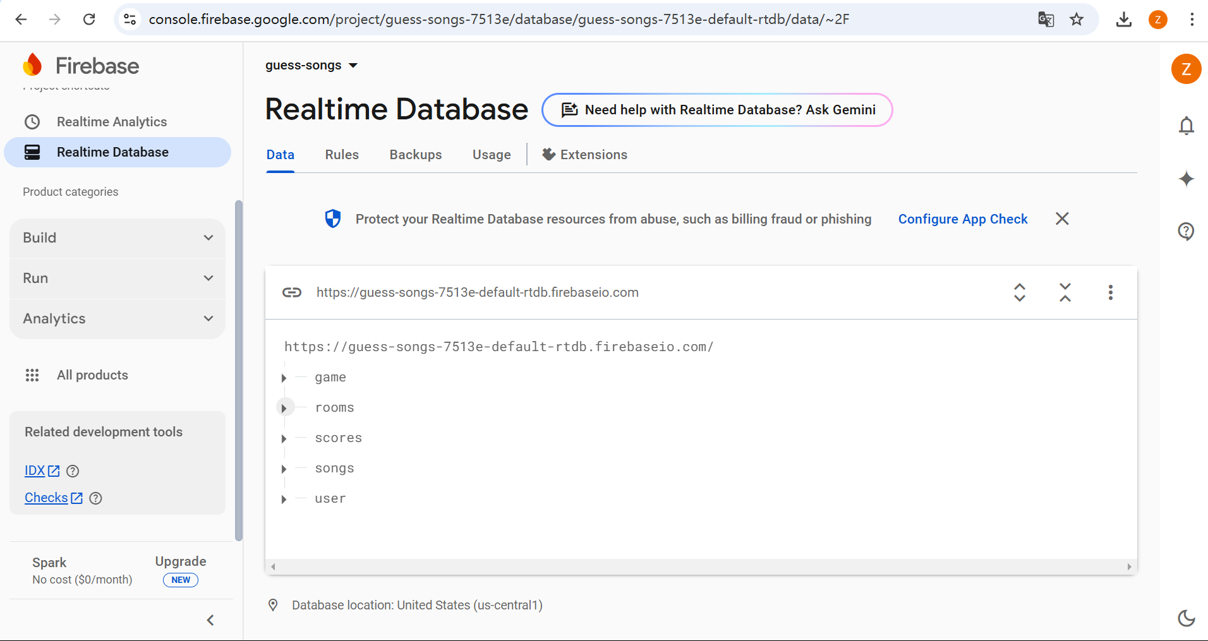

Slide 14
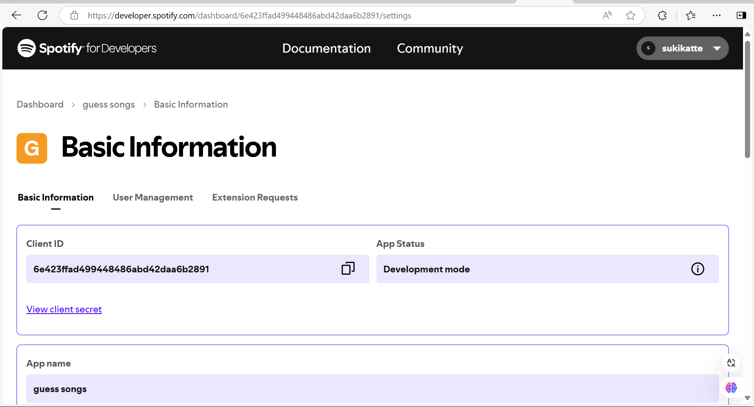

Slide 15
Challenges & Next Steps
Challenges:
Synchronization of player answers and scores during the game.
Full integration with Spotify API to handle song playback.
Next Steps:
Implement real-time syncing of answers, scores, and current questions in multiplayer mode.
Finalize Spotify connection for dynamic song playback from Firebase.
Add features for game administrators or players to add new songs to the song library.

Slide 16
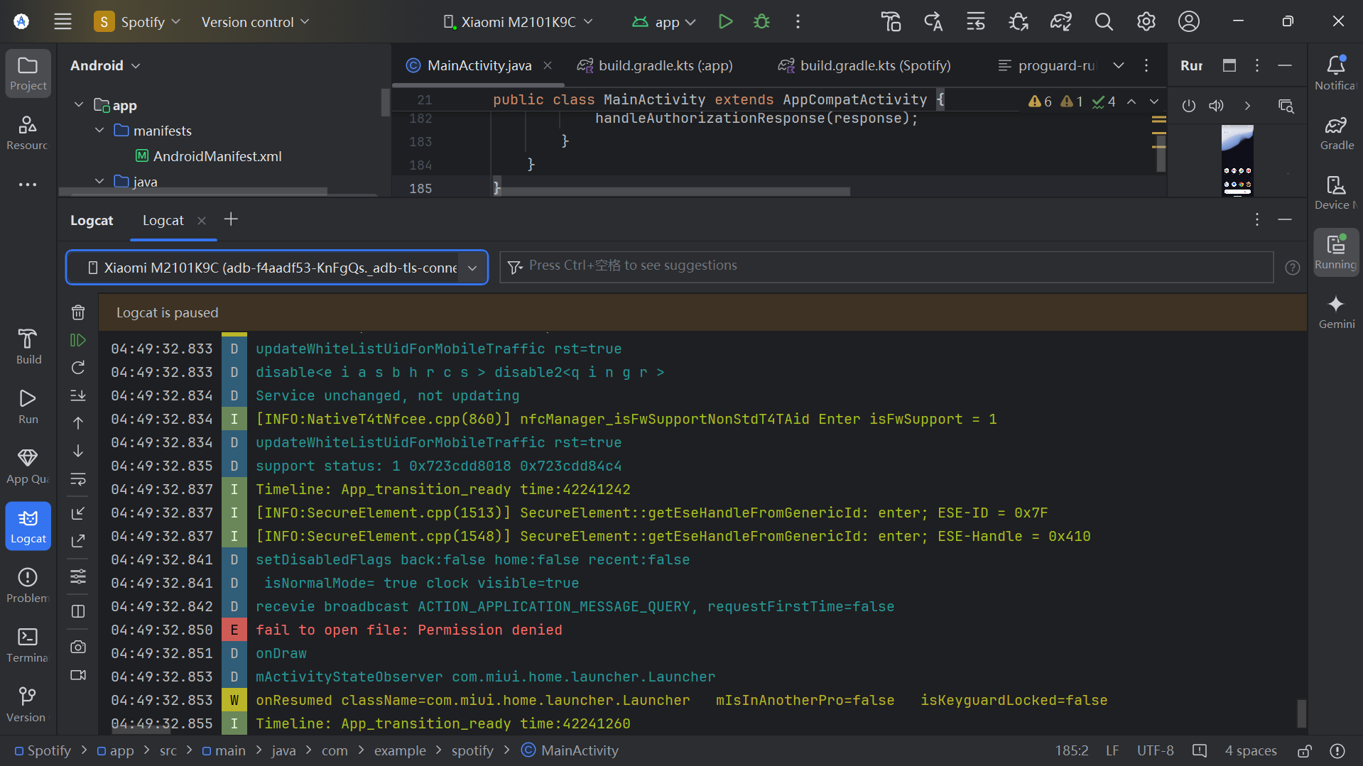

Slide 17
Tech Stack
Android SDK: For app development.
Spotify SDK: For integrating music playback.
Firebase Realtime Database: For real-time data syncing and user score management.

Slide 18
Final’s Implementation

Slide 19
Final-Update My Final Goal
Making "Guess Songs" to be a music & game application that combines a music player and a song-guessing game that is highly playable.

Slide 20
New Features Implemented
Completed multiplayer mode (the previous phase only implemented room connectivity, this phase completed the game functionality).
Completed Endless Mode and its leaderboard.
Integrated the use of the online music library for song storage (OSS + Real-time Database).
Added a music player feature (allows querying, playing, pausing, and switching music).
Added a user-upload functionality (the library is updated in real-time, and newly uploaded songs appear in the guessing game).
Designed innovative UI, including the navigation bar and music player bar.

Slide 21
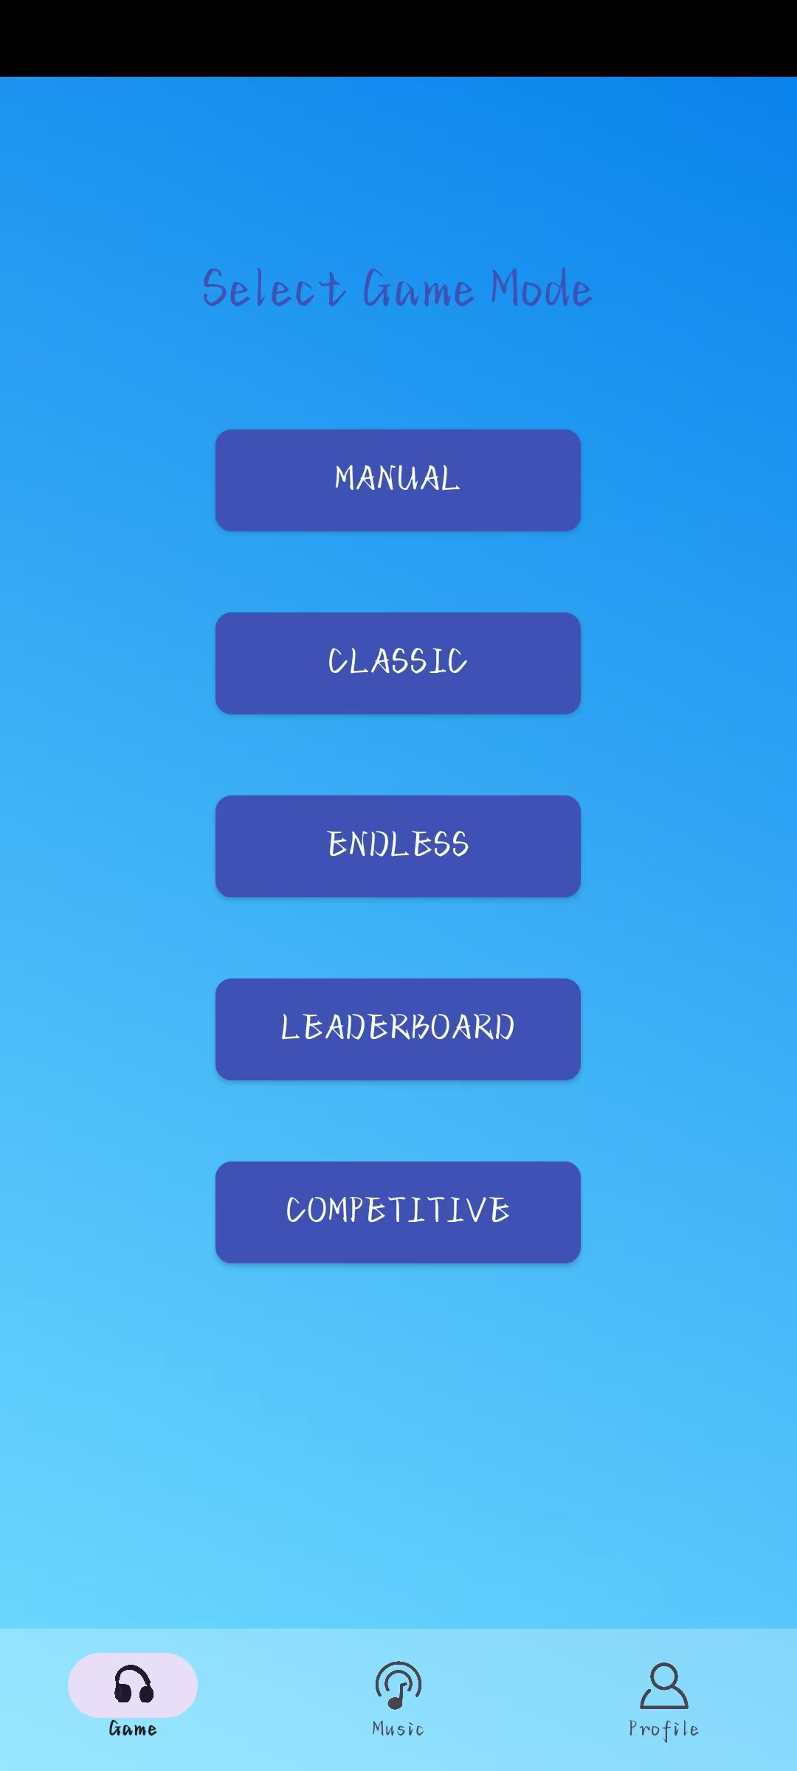
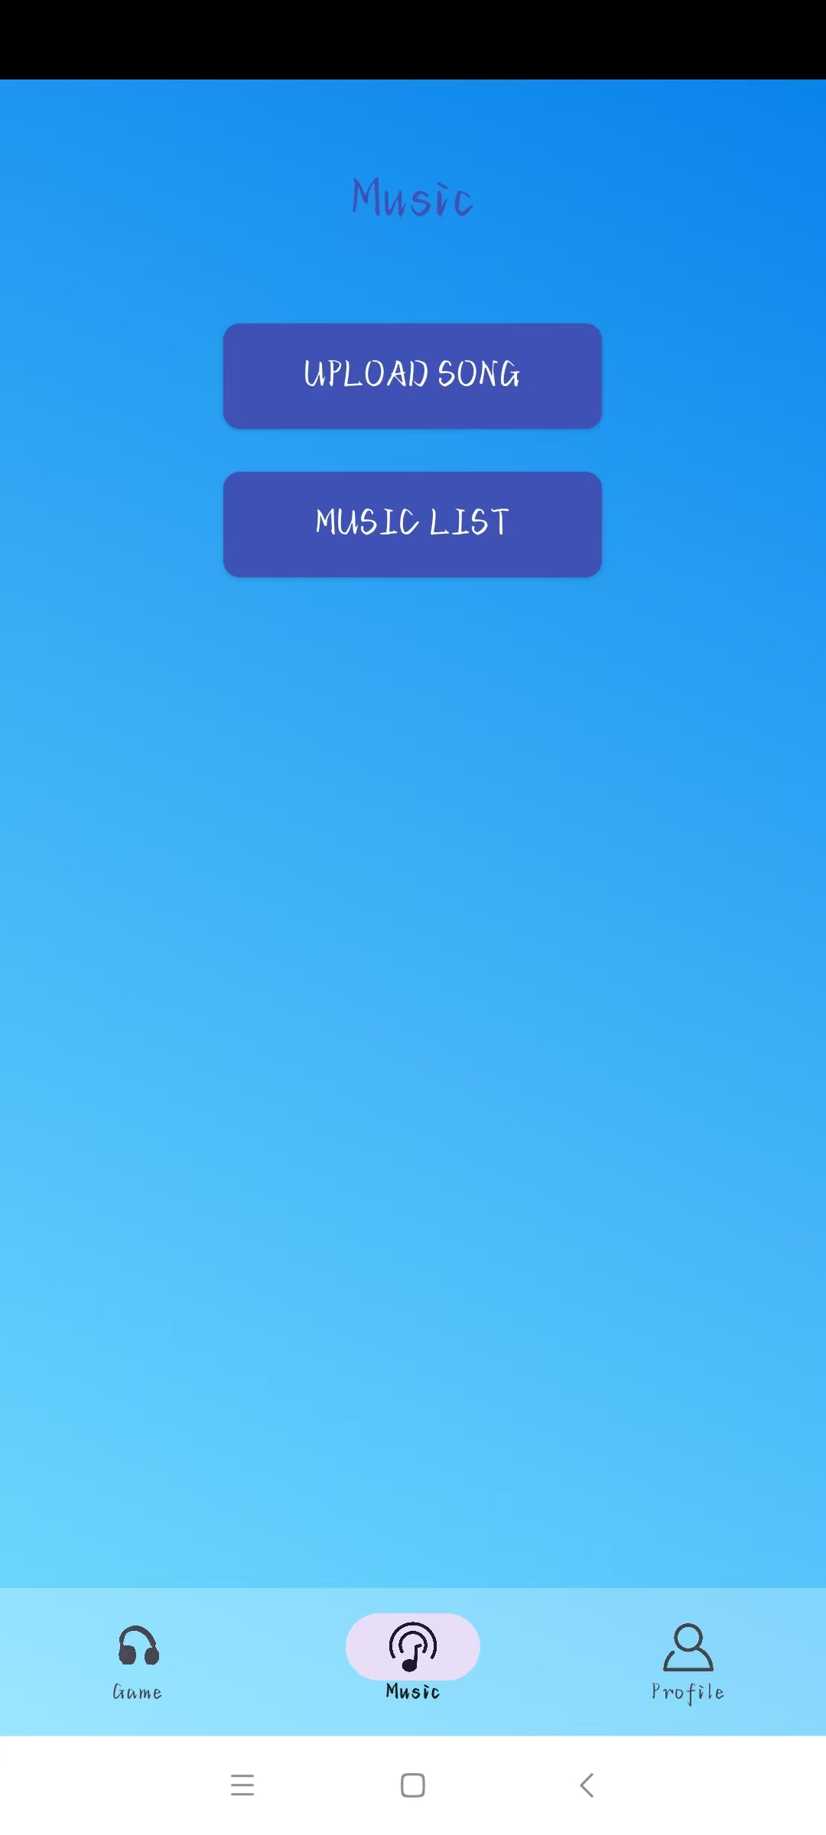
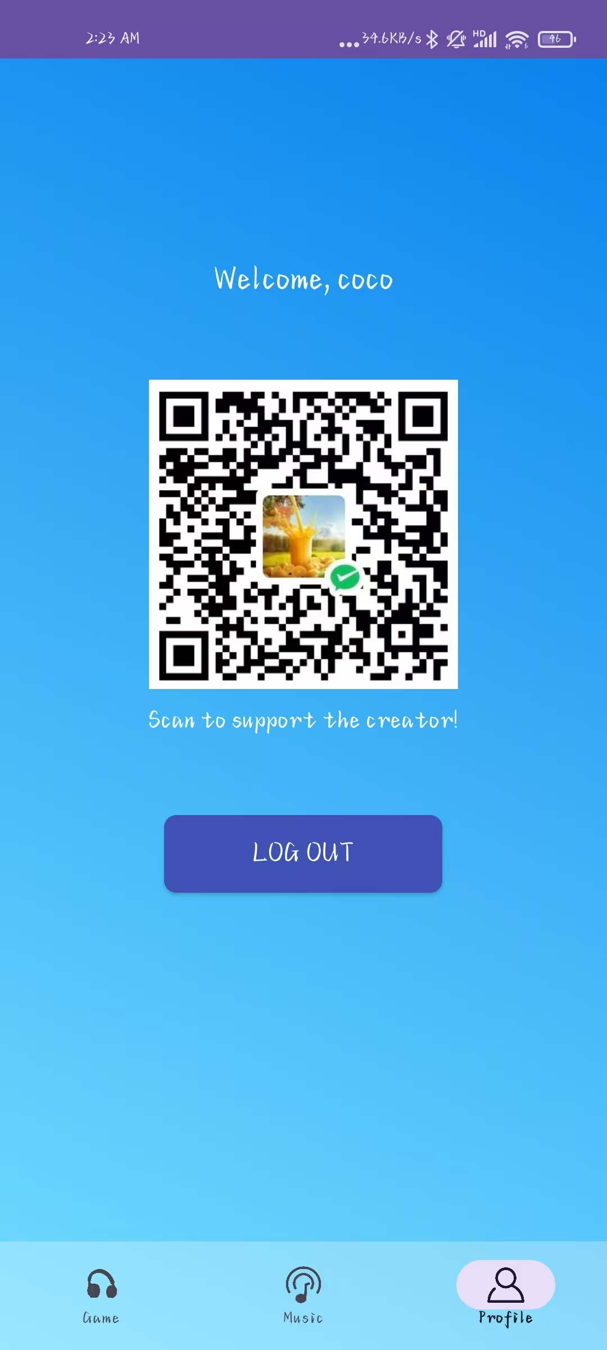
Bottom Navigation

Slide 22
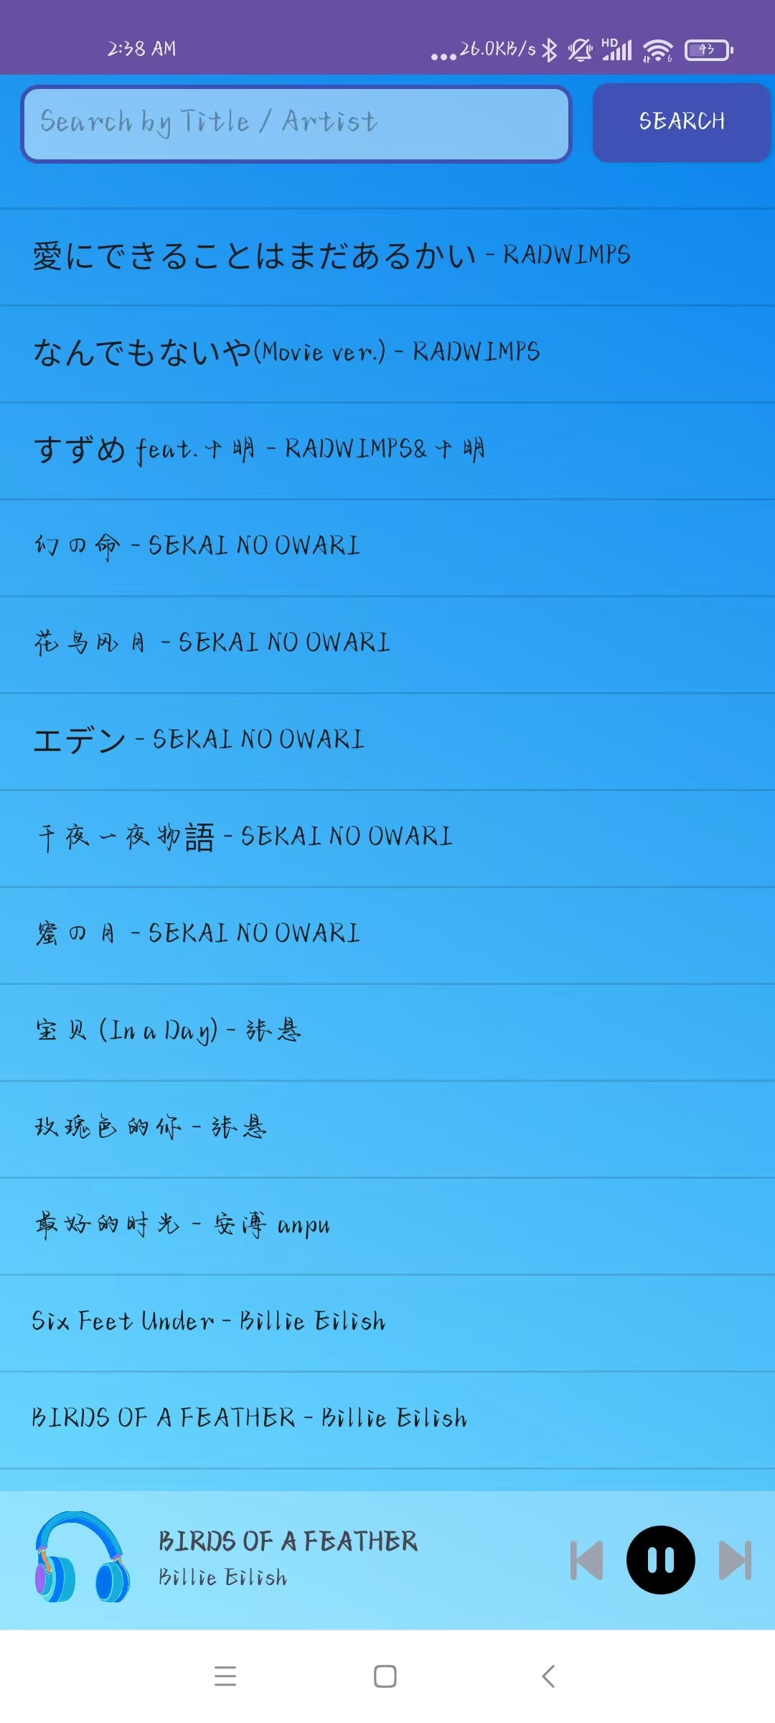
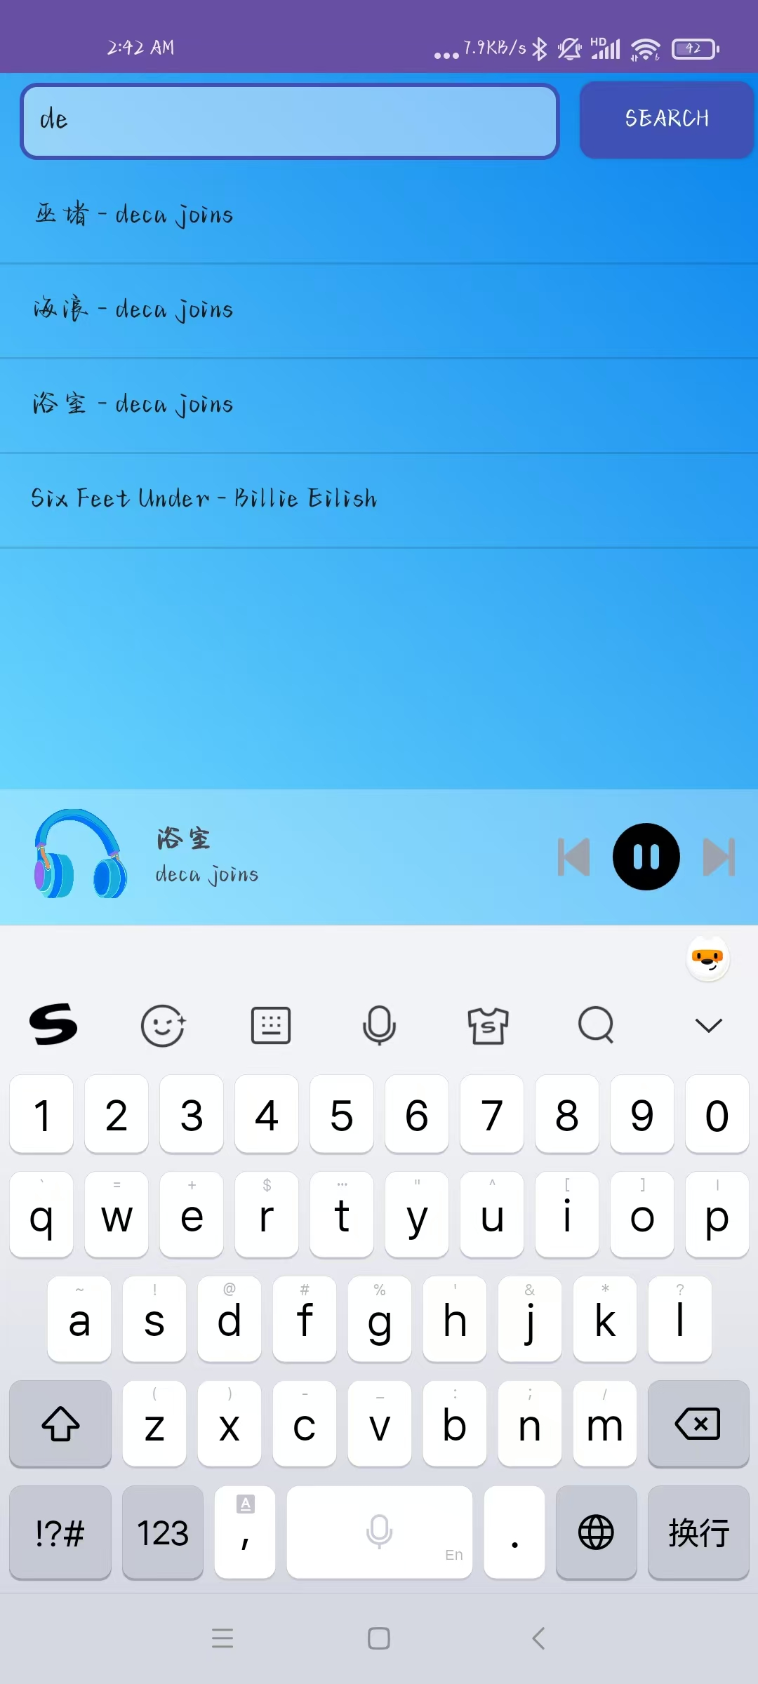
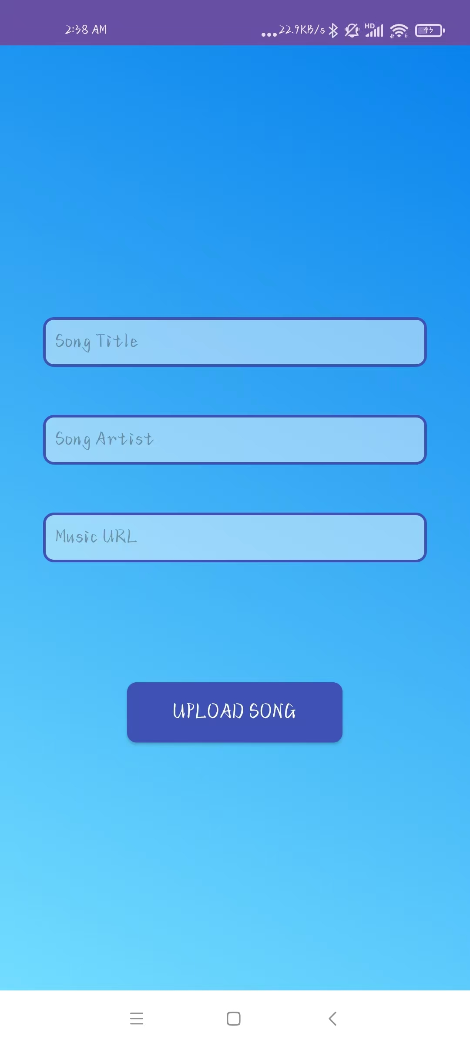
Music List and Music Uploads

Slide 23
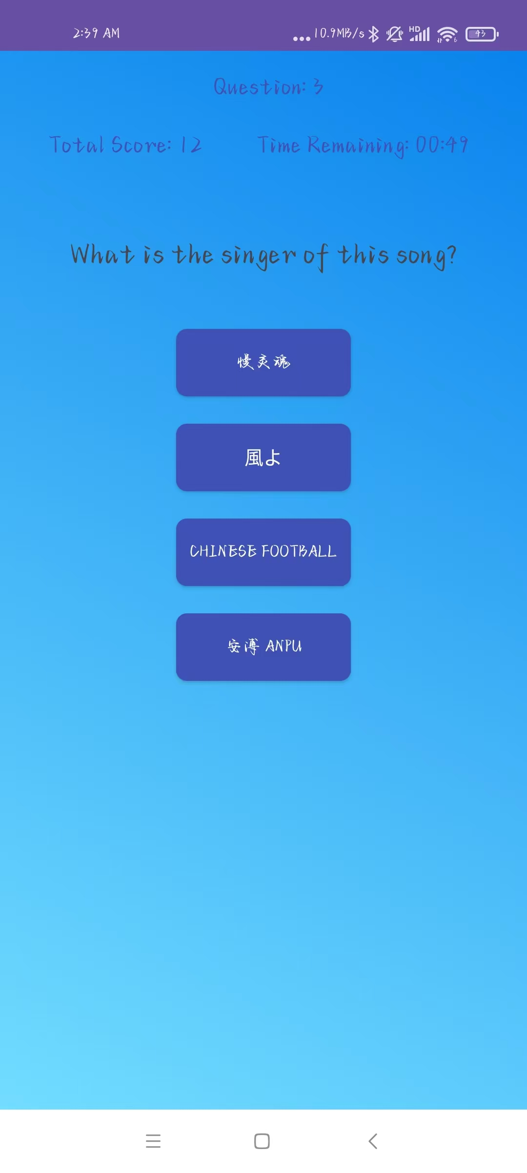
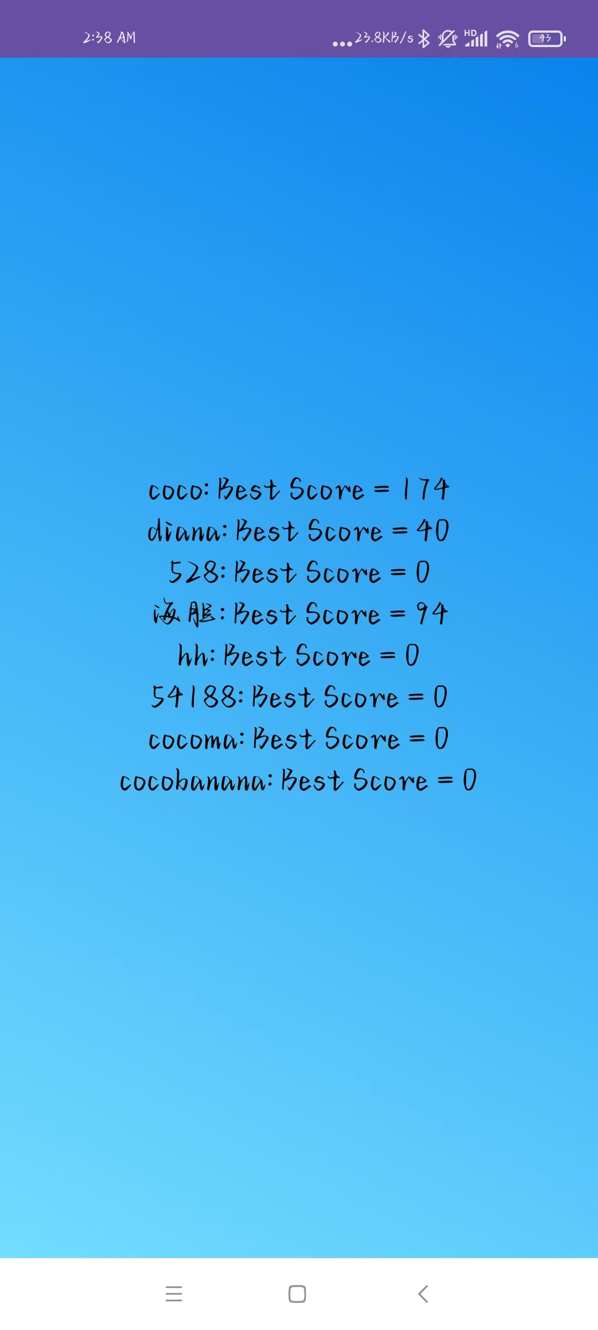
Endless Mode and Leaderboard
Endless Mode: features the ability to answer an unlimited number of questions within a limited time, with the highest score of all players being recorded on the client-side leaderboard. The leaderboard updates in real-time.

Slide 24
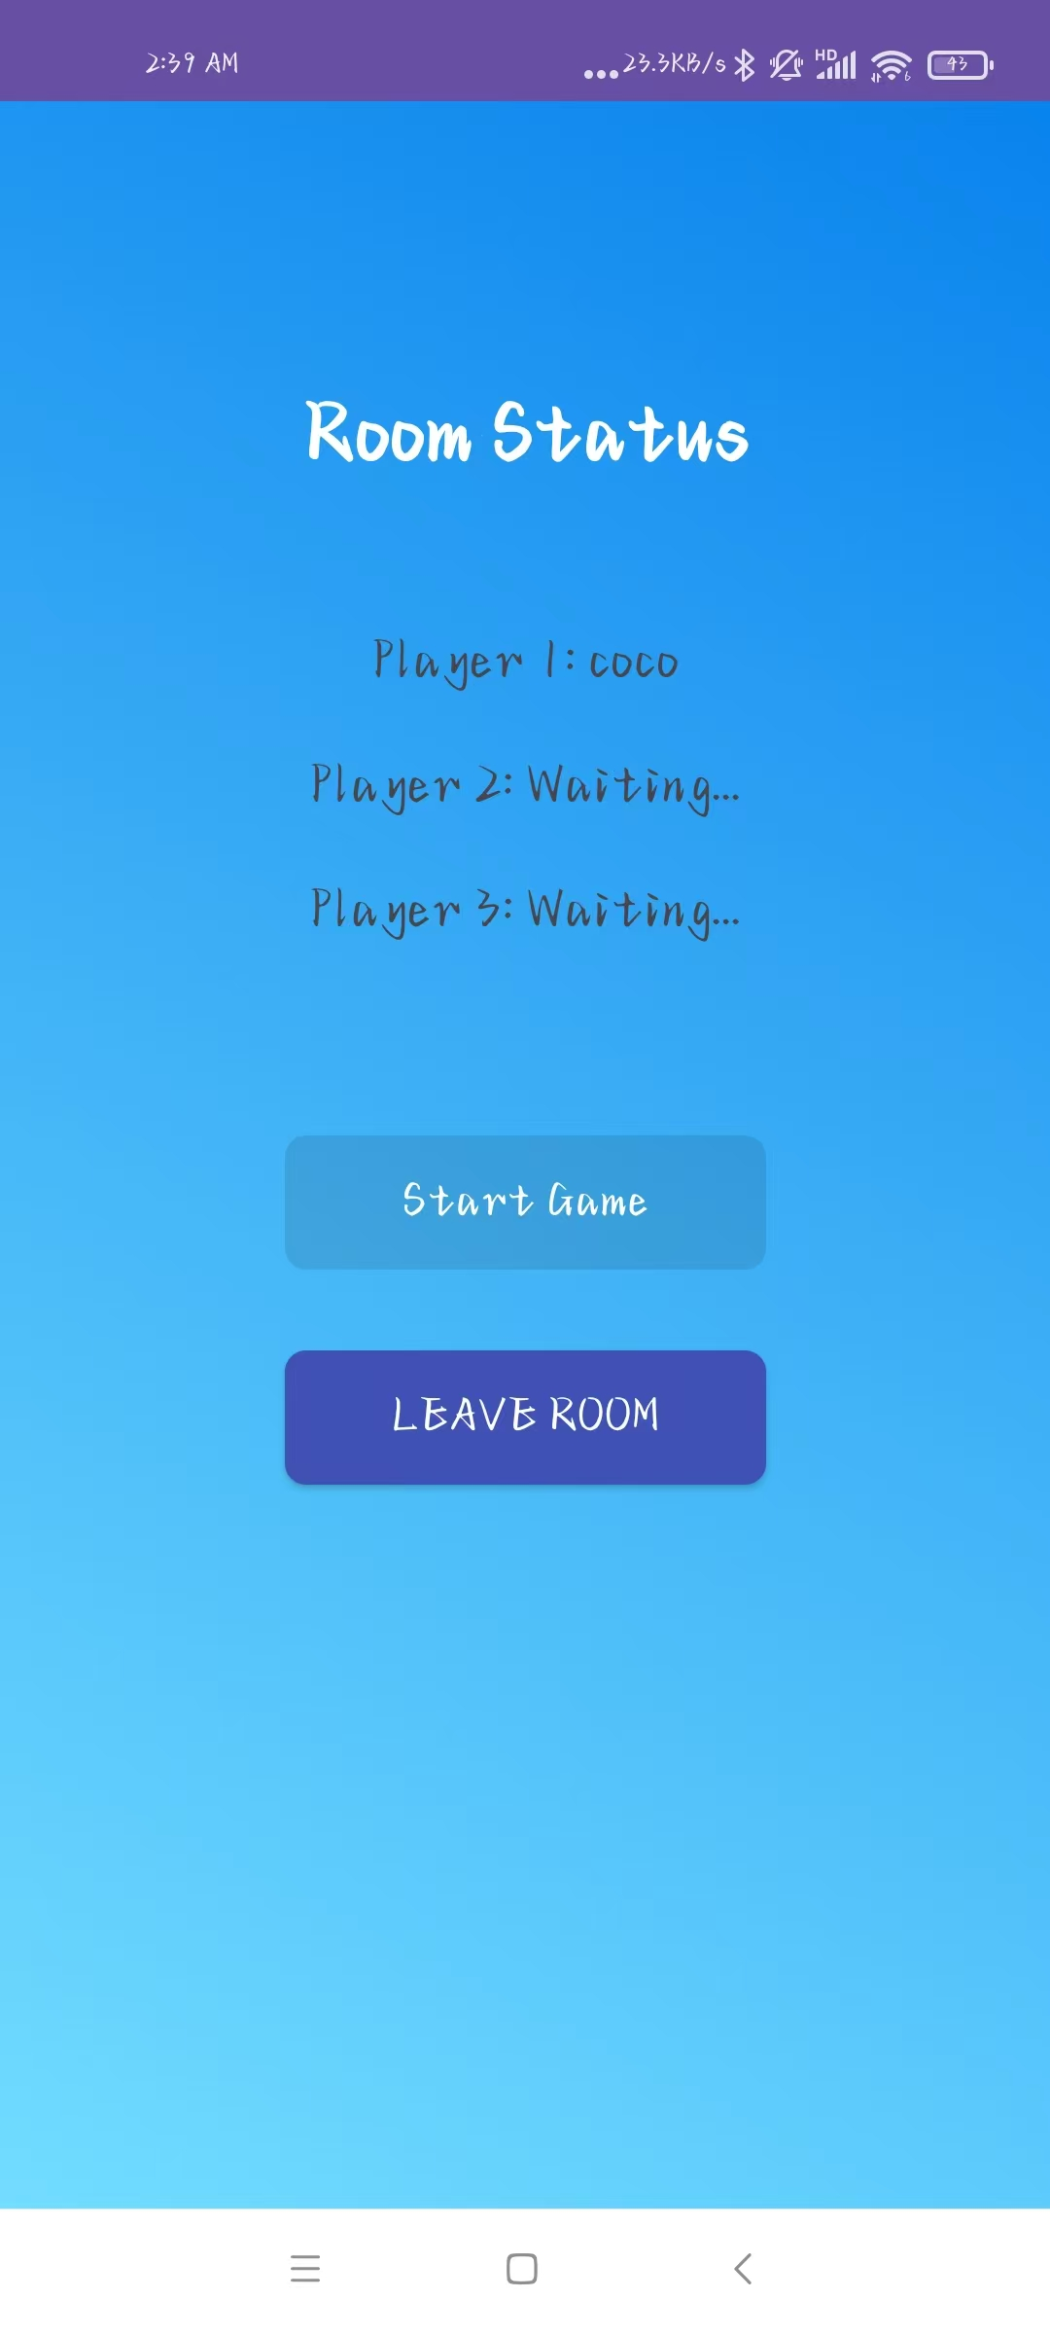
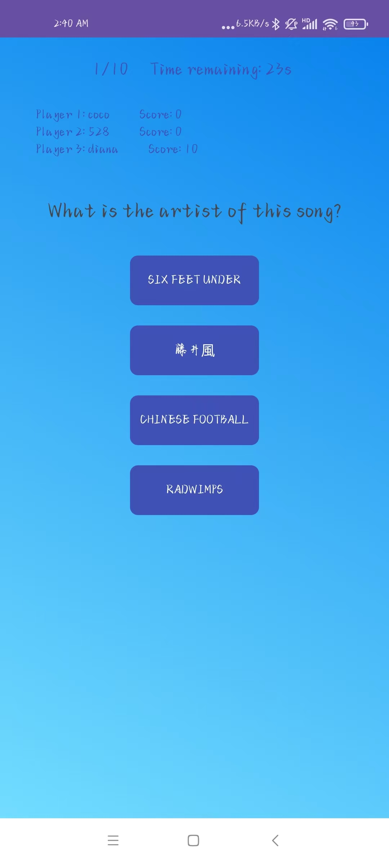
Competitive Mode
Multiplayer: enables multiple players to compete in the same game. After creating a 3-player room, all three players will compete in the same game, and their scores will be communicated.

Slide 25
Tools Used
Development Environment: Android Studio, Java
Database: Firebase Real-time Database (see Figure 1) (Access Link: https://guess-songs-7513e-default-rtdb.firebaseio.com)
(Firebase Console Access Link:
https://console.firebase.google.com/project/guess-songs-7513e)
User Authentication: Firebase Authentication
Music Storage: Alibaba Cloud Object Storage Service (OSS) (see Figure 2)
Audio Playback: Media Player (import android.media.MediaPlayer)

Slide 26
Project Summary
In this project, I have learned how to independently develop software, from concept and design to testing. Moreover, I believe that the most valuable aspect of this experience was learning how to search for and reference resources effectively.
For example, initially, I intended to use the Spotify Developer API to build an online song library. However, after spending a long time on configuration, I realized that mobile devices in China cannot access Google Play, and I was unable to download the latest Spotify client, which meant I couldn't use the API.
Although this was a failed attempt, the process of following the official Spotify tutorials to import dependencies and build the framework was incredibly meaningful. It allowed me to gain a deep understanding of what software development entails and what is specifically required in mobile computing.
Although this project took a long time to complete and still has areas that could be improved, it was an incredibly valuable and meaningful personal practice.

Slide 27
That is all, Thank you for watching!

